Slide 1



Graduate Admissions: Predictive Modeling & Statistical Analysis
Final Project – Data Analysis and Modeling
Chen Sihan – 202330420212

Slide 2
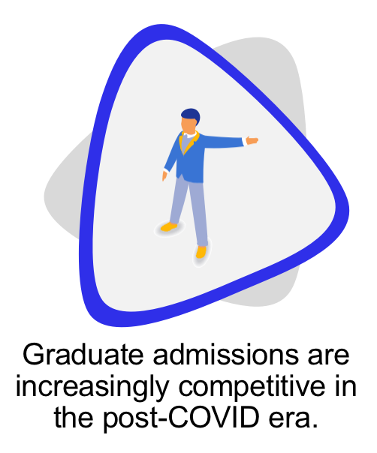
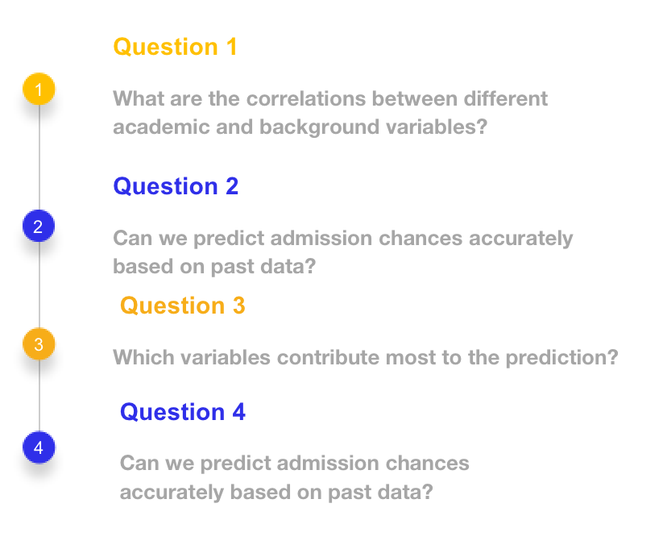

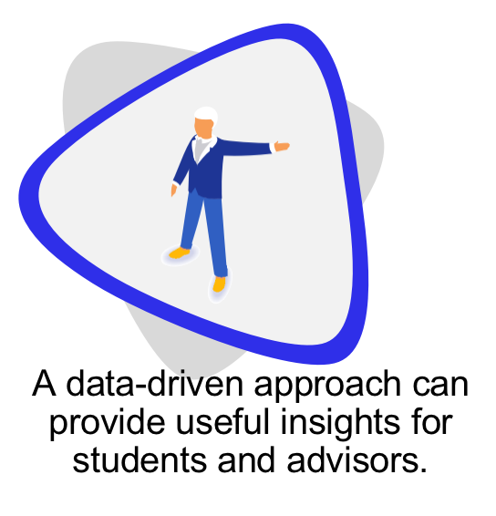
Motivation & Research Questions
Question 1
1
What are the correlations between different academic and background variables?
Question 2
2
Can we predict admission chances accurately based on past data?
Question 3
3
Which variables contribute most to the prediction?
Question 4
4
Can we predict admission chances accurately based on past data?

Slide 3
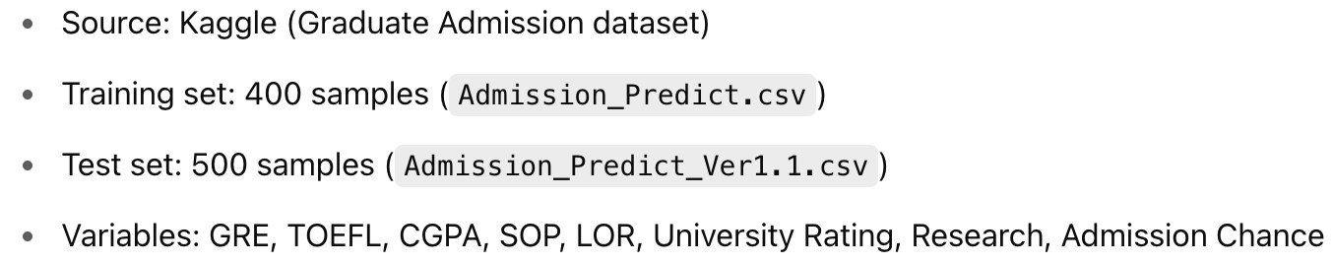
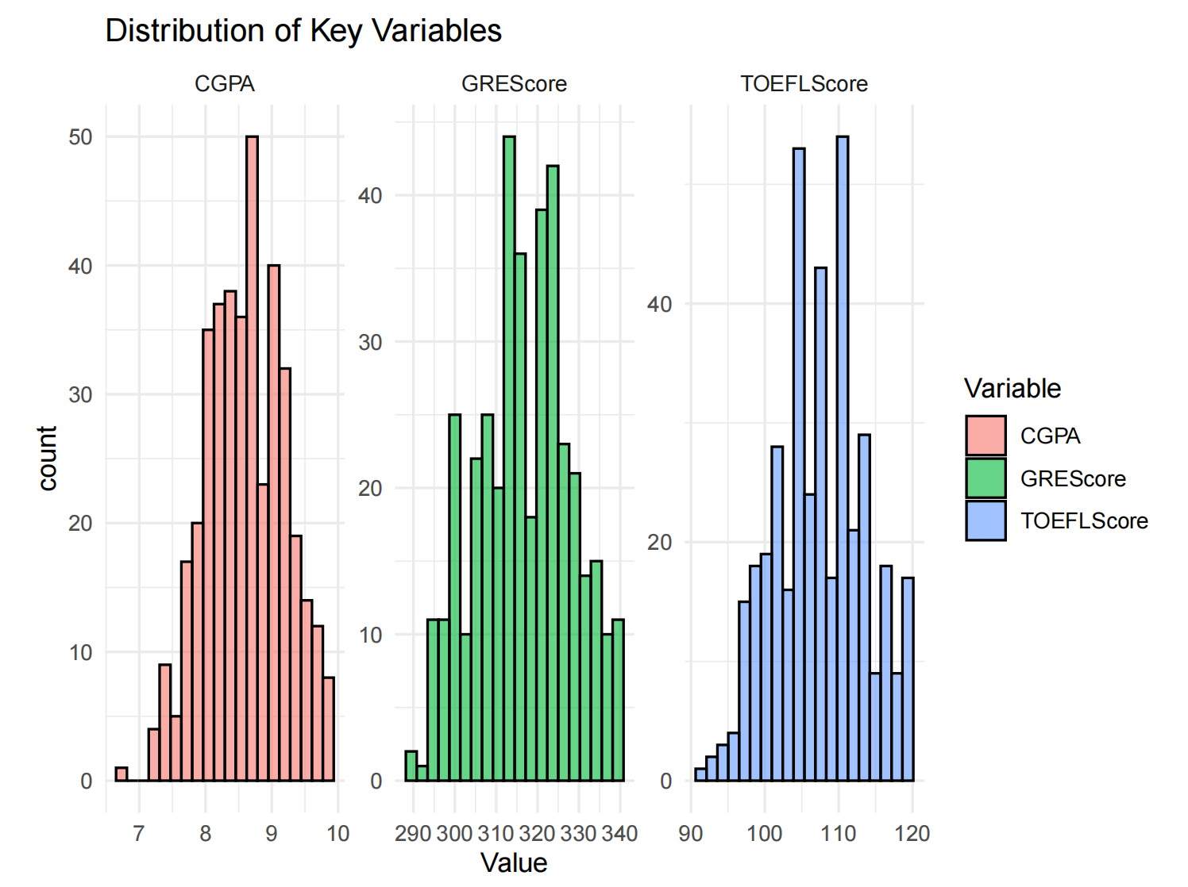
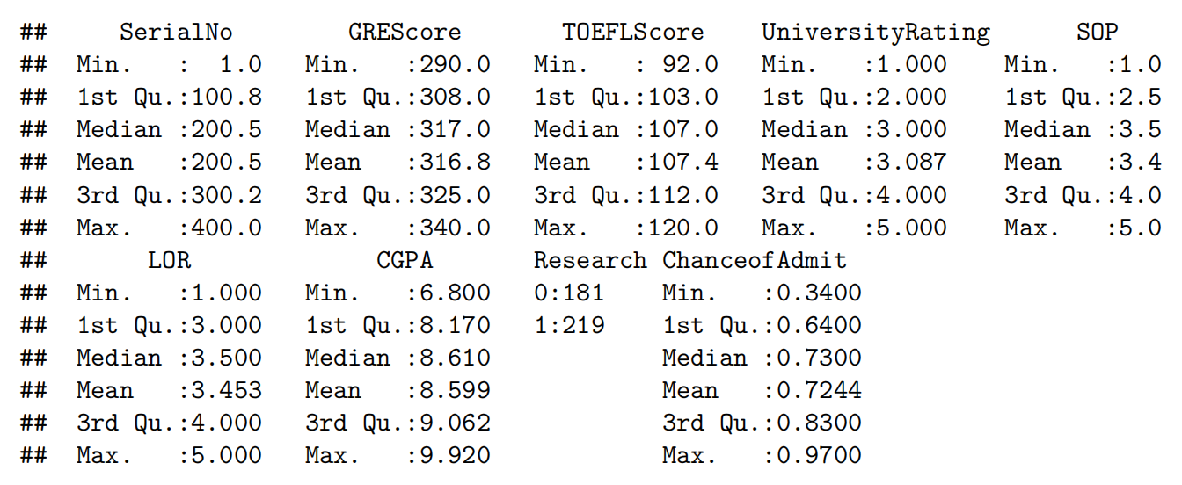
Data Overview & EDA Highlights

Slide 4
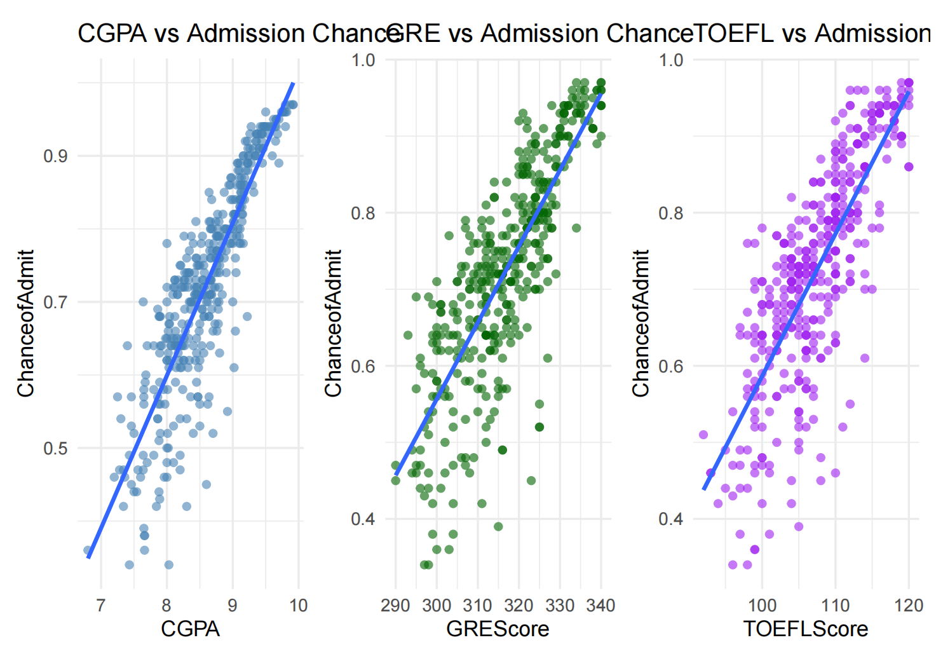
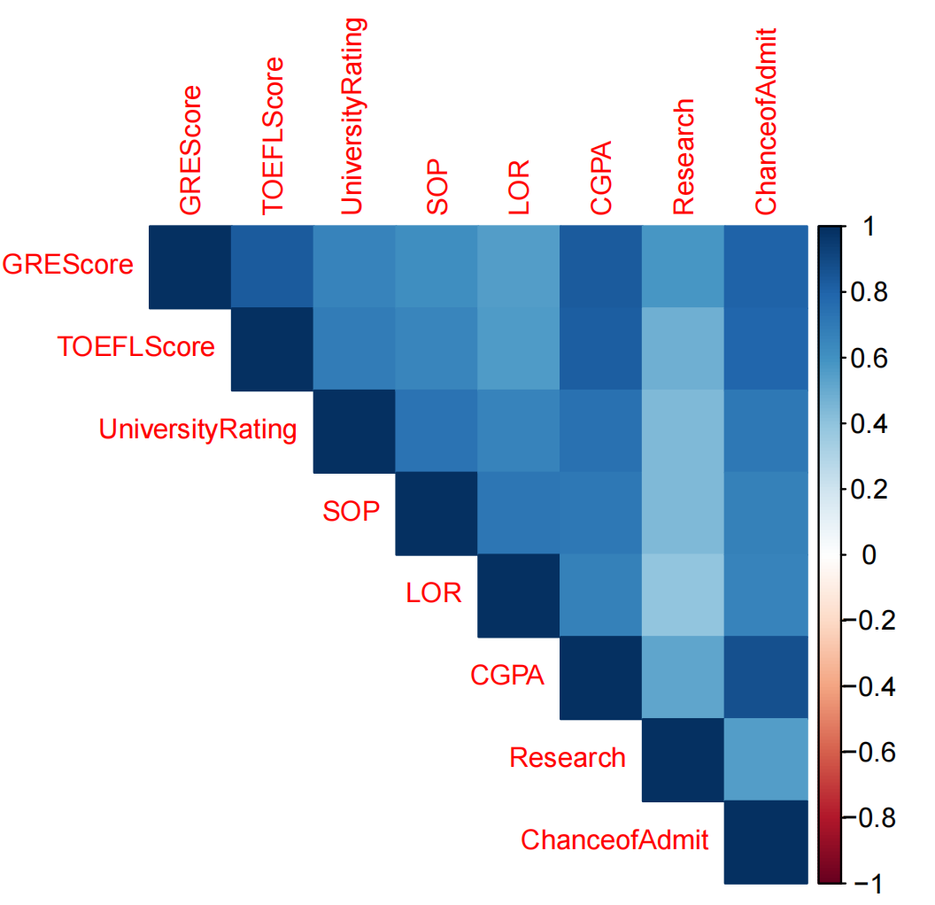
Exploratory Analysis & Correlation
These scatter plots show strong positive linear relationships between CGPA, GRE scores, and TOEFL scores with the chance of admission.
Among them, CGPA has the tightest clustering and highest correlation, indicating it is the most reliable predictor.
GRE and TOEFL also display upward trends, but with slightly more dispersion.
The correlation heatmap confirms that CGPA (r ≈ 0.87), GRE (r ≈ 0.80), and TOEFL (r ≈ 0.79) are most strongly correlated with admission chances.
Other variables like SOP and LOR show moderate correlation, while research experience is positively correlated, though less strongly.
The heatmap also indicates that multicollinearity between features is mild, allowing reliable regression modeling.

Slide 5
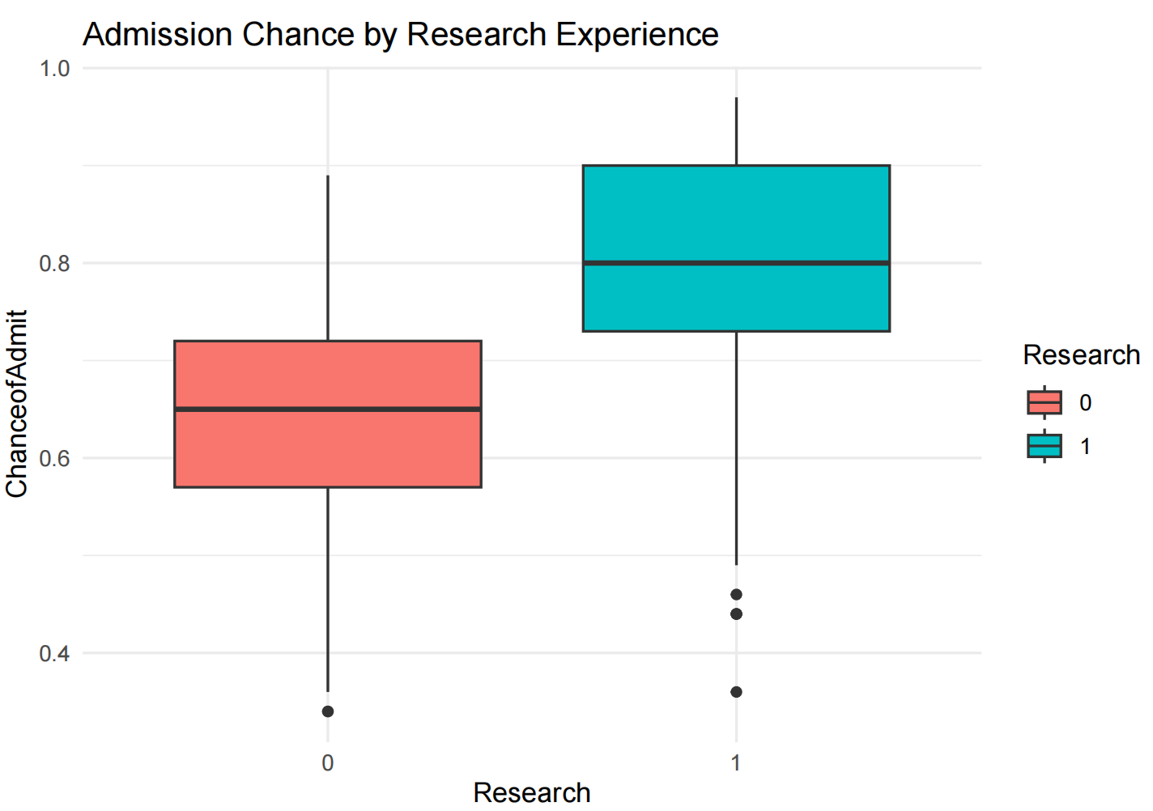
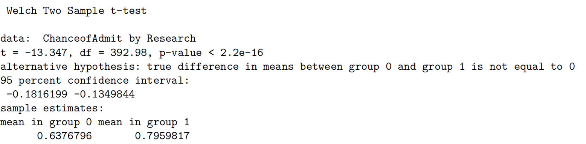
Research Impact & Statistical Testing
Does research experience impact admission?
The boxplot clearly shows that students with research experience (coded as 1) have higher average
chances. The t-test confirms this difference is statistically significant (𝑝 < 0.001).

Slide 6
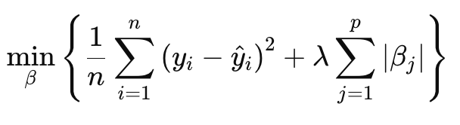
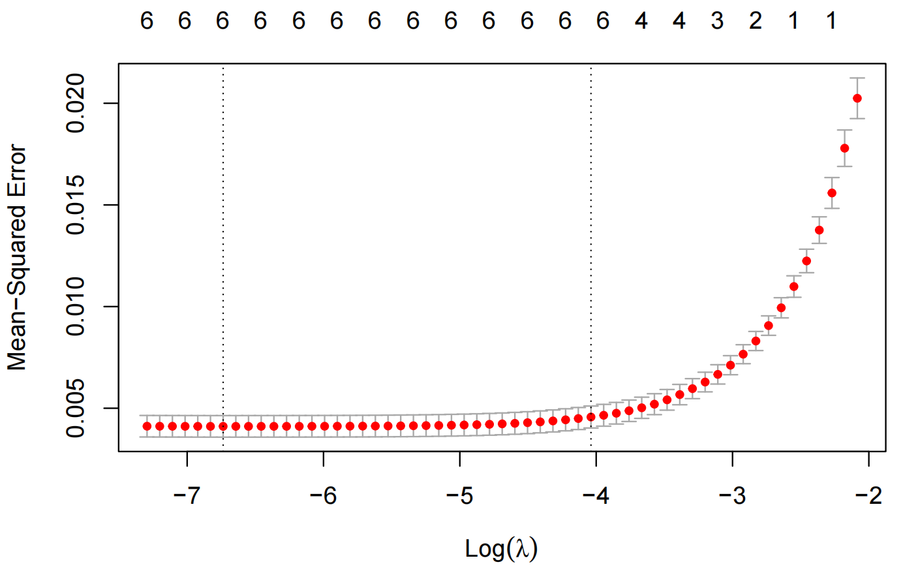
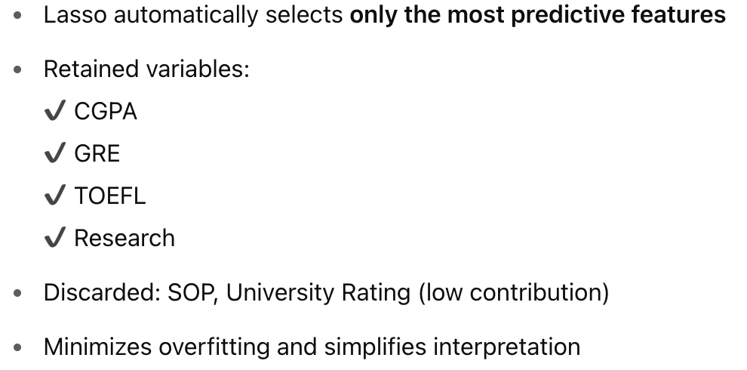
Í
Modeling Results & Lasso Interpretation

Slide 7
THANKS
To conclude:
CGPA, GRE, TOEFL show the strongest correlation with admission chances.
Admission probability can be accurately predicted using linear regression.
Research experience has a significant impact, supported by statistical testing.
The model generalizes well and can serve as a reference for students planning to apply.
Though useful, the dataset doesn't include discipline, ethnicity, or recommendation content, which limits its scope. Future work could extend the model with these richer features.

